Slide 1
CE887-7-AU : Natural Language Engineering Assignment1 report
Name: Yaowei Lyu
LYUYA32506
MSc Big Data and Text Analytics (MSC)

Slide 2
Question 1

Slide 3
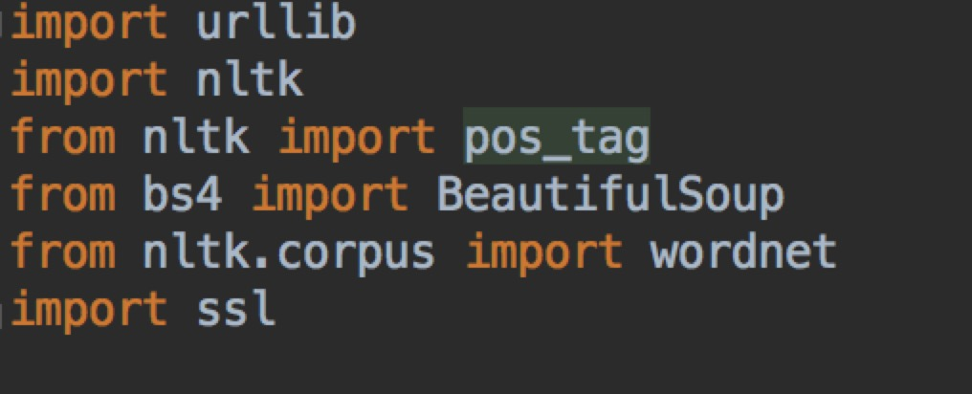
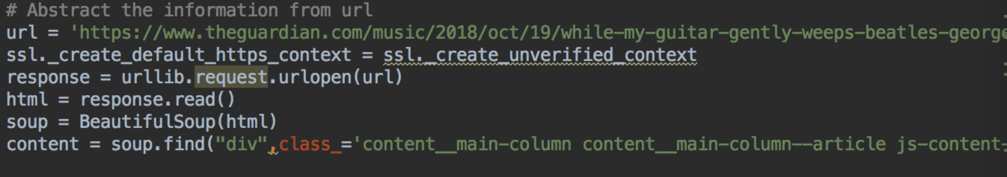
Import packages
Get the text from url by using BeautifulSoup function from bs4 packages
There is a function in BeautifulSoup is ‘find’,the ‘div’is the type of html and ‘class_’ is the name of ‘div’. After this we can obtain messages from
Html value

Slide 4
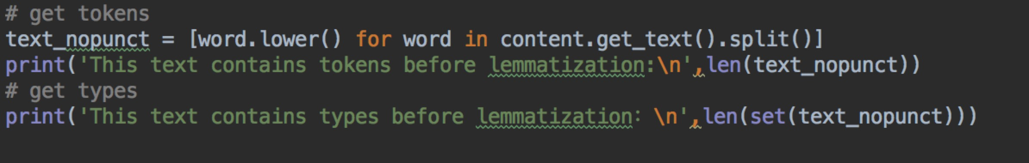
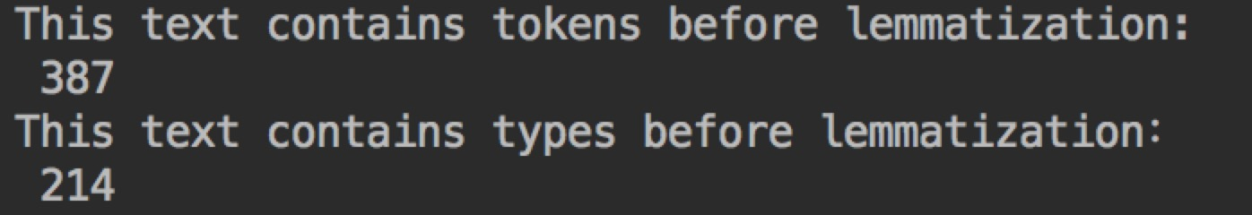
Get the tokens from the text from html, we need to notice that content is a list so we need to use get_text to get the text. Set(text_nopunct) can get the unique word of text, which is types of text
Results is :

Slide 5
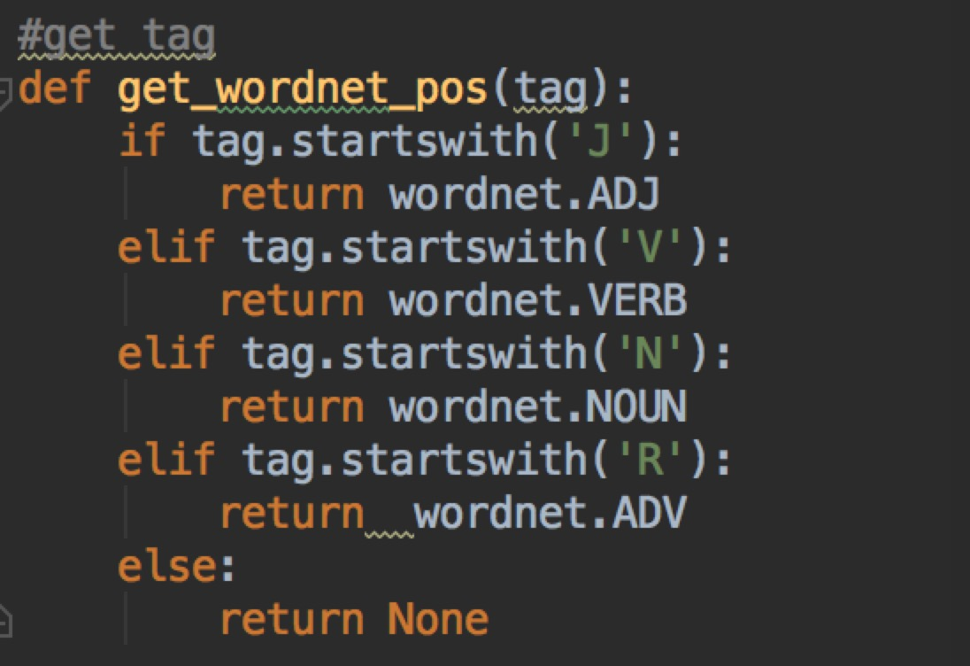
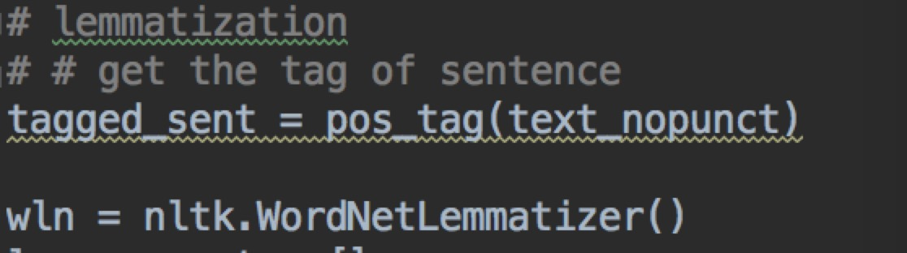
Lemmatizon:
Get the tag of each word
By using own function get_wordnet_pos(),we need to input the tag of word and we can search in wordnet and get the POS of text
Lemmatize word by using nltk.WordNetLemmatizer()

Slide 6
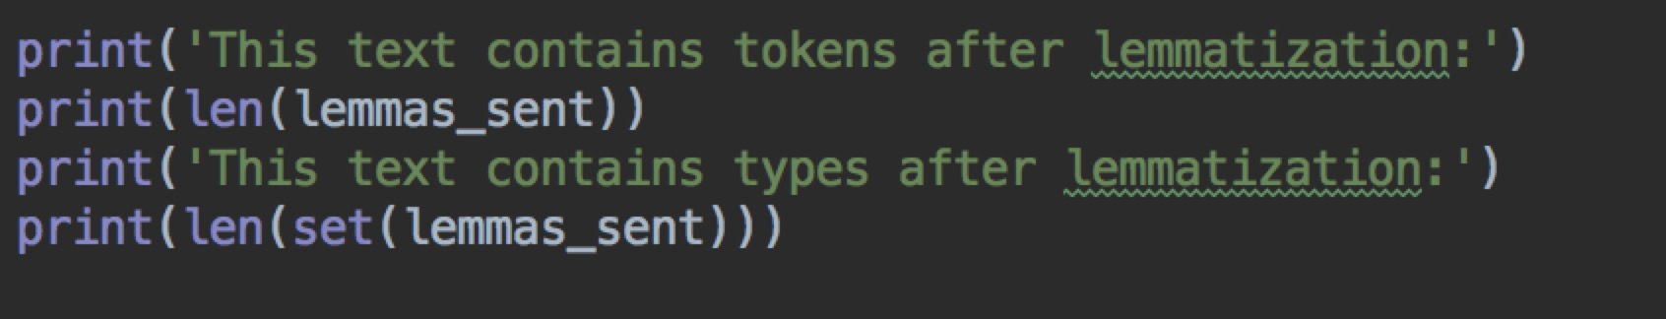
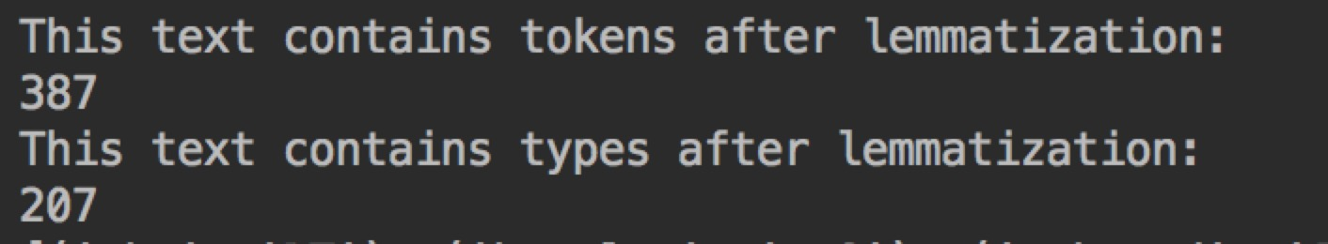
Get the result after lemmatization

Slide 7
Question 2

Slide 8
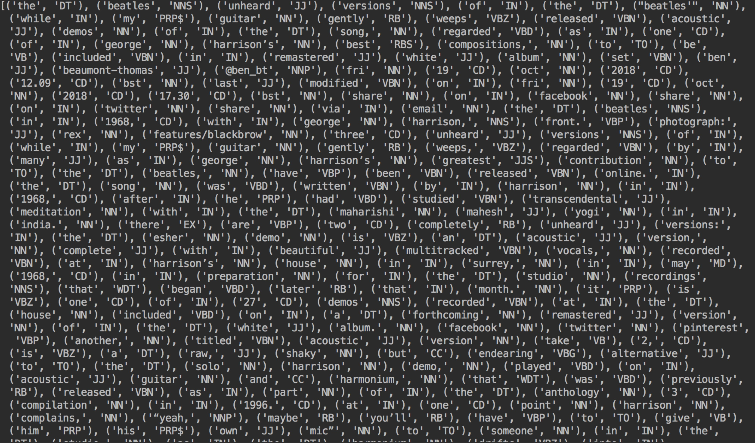
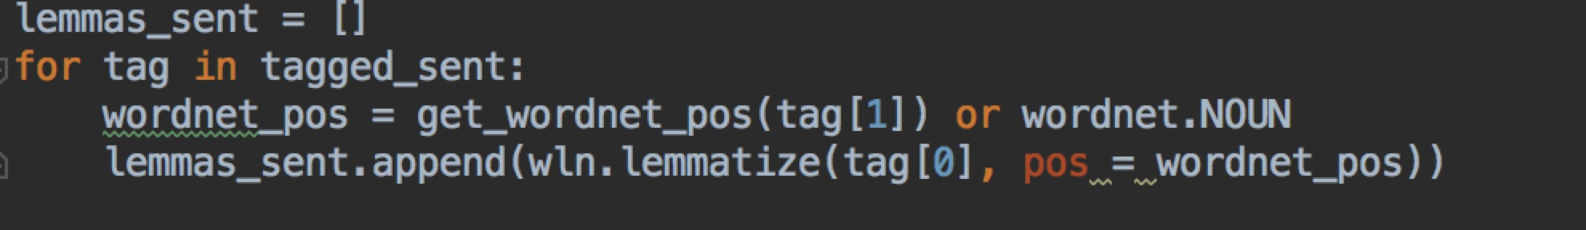
Q2、Assign pos tag to each word

Slide 9
Q2: ·In the sentence “Acoustic demos of the song, regarded as one of George Harrison’s best compositions, to be included in premastered White Album set”: · ‘demos’(NNS) was tagged with NN. This word might use the most popular pos · ‘regarded’(VBN) was tagged with VBD. Because the punition ‘,’ is removing and it is hard to treat regarded as VBD ·'set'(NN) was tagged with VBN. Because ’\n’ is removed ,and set might comprise a another phrase with following words · In the sentence 'Ringo Starr infamously .... didn’t want to eat spicy food, and left after two weeks.": 'spicy'(JJ) was tagged with NN. Because most of words end with –cy is noun.

Slide 10
Question 3

Slide 11
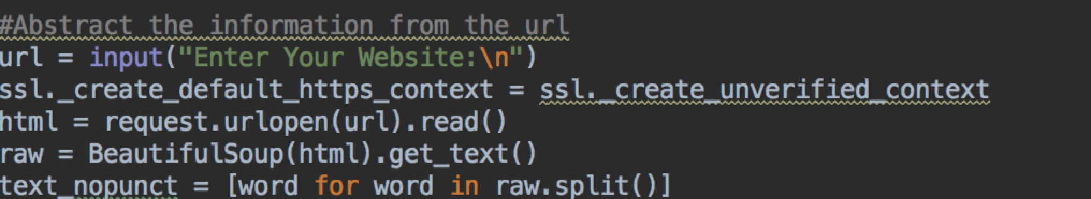
Question 3
Regular expression
Get the text from url

Slide 12
Question 4

Slide 13
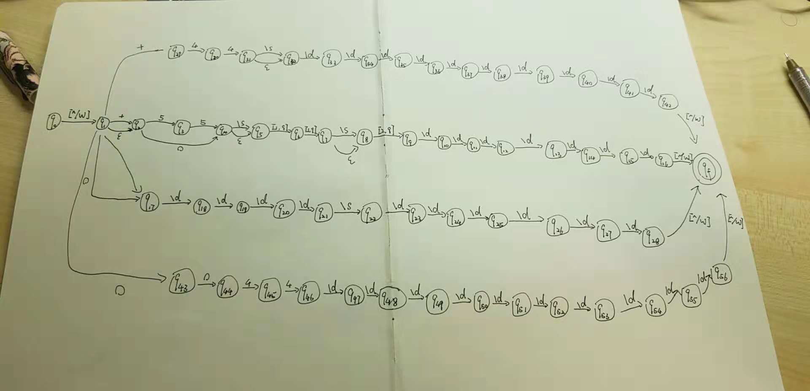
· FSA

Slide 14
Question 5

Slide 15
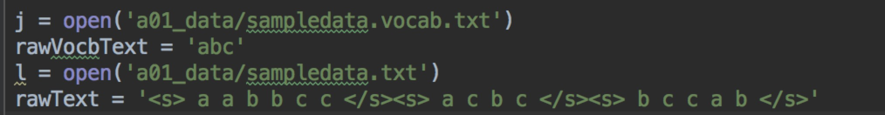
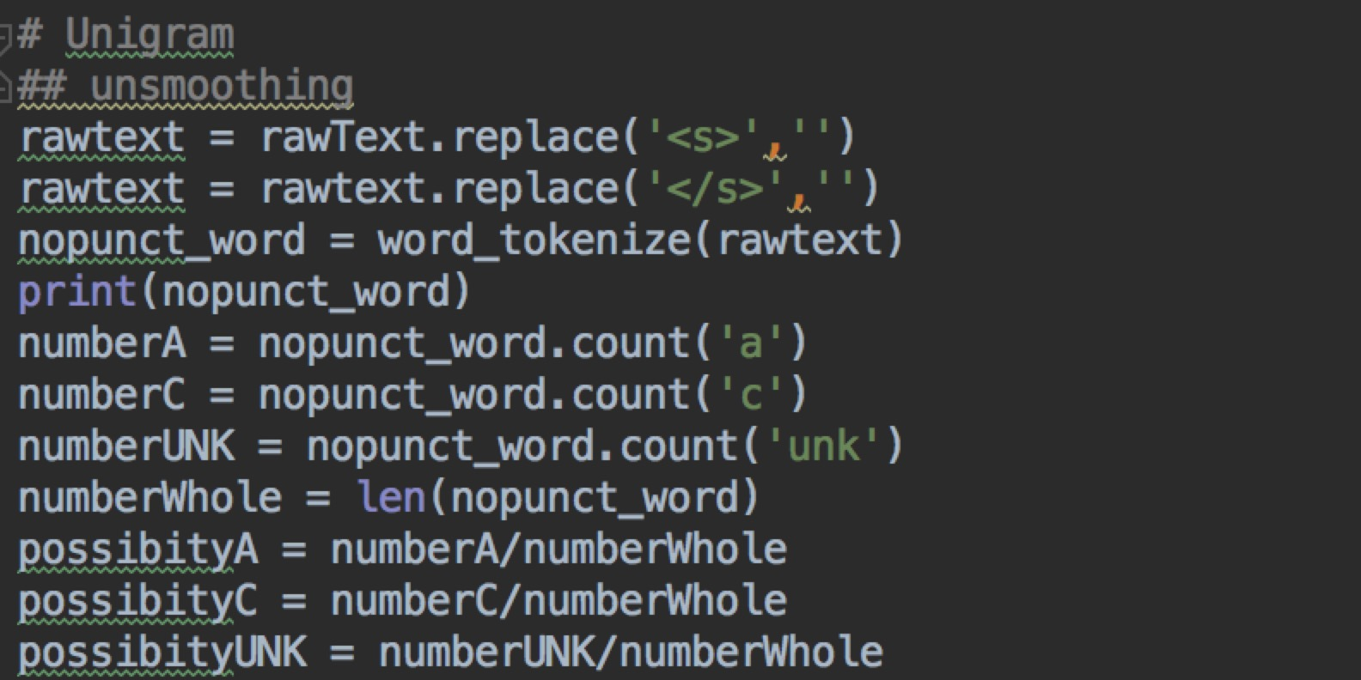
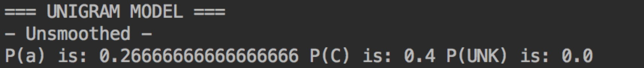
Open file and get the initial data
Clear the data ,remove <s> and </s>,then tokenize the sentence, get the count of ‘a’ , ’c’ and ‘UNK’, then compute the possibility

Slide 16
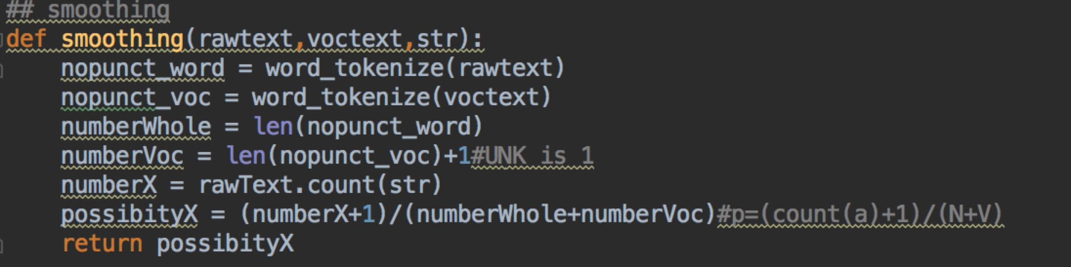
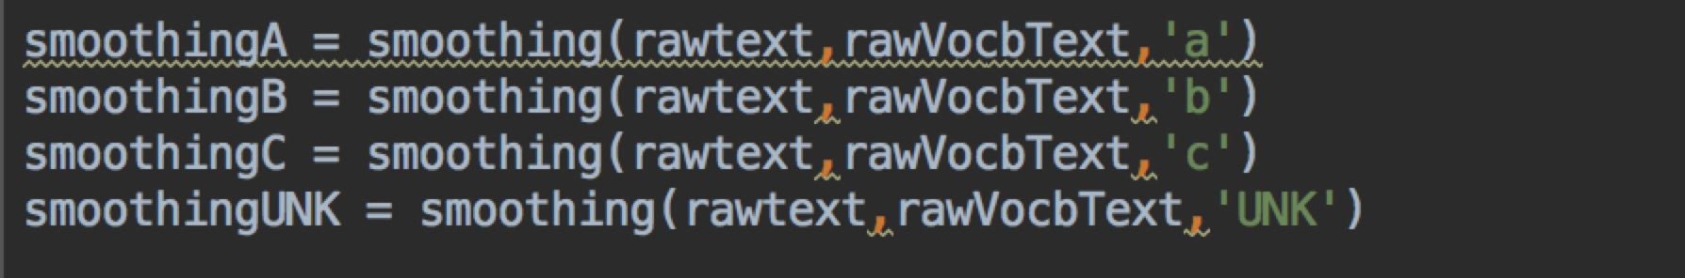
After finish unsmoothing, we need to smoothing, we need to input the N(tokens),V(vocabulary number),and String(which one do you want to smooth),return the possibility
P=(count(str)+1)/(count(N)+count(V))
Compute the possibility of a, c and UNK

Slide 17
Question 6

Slide 18
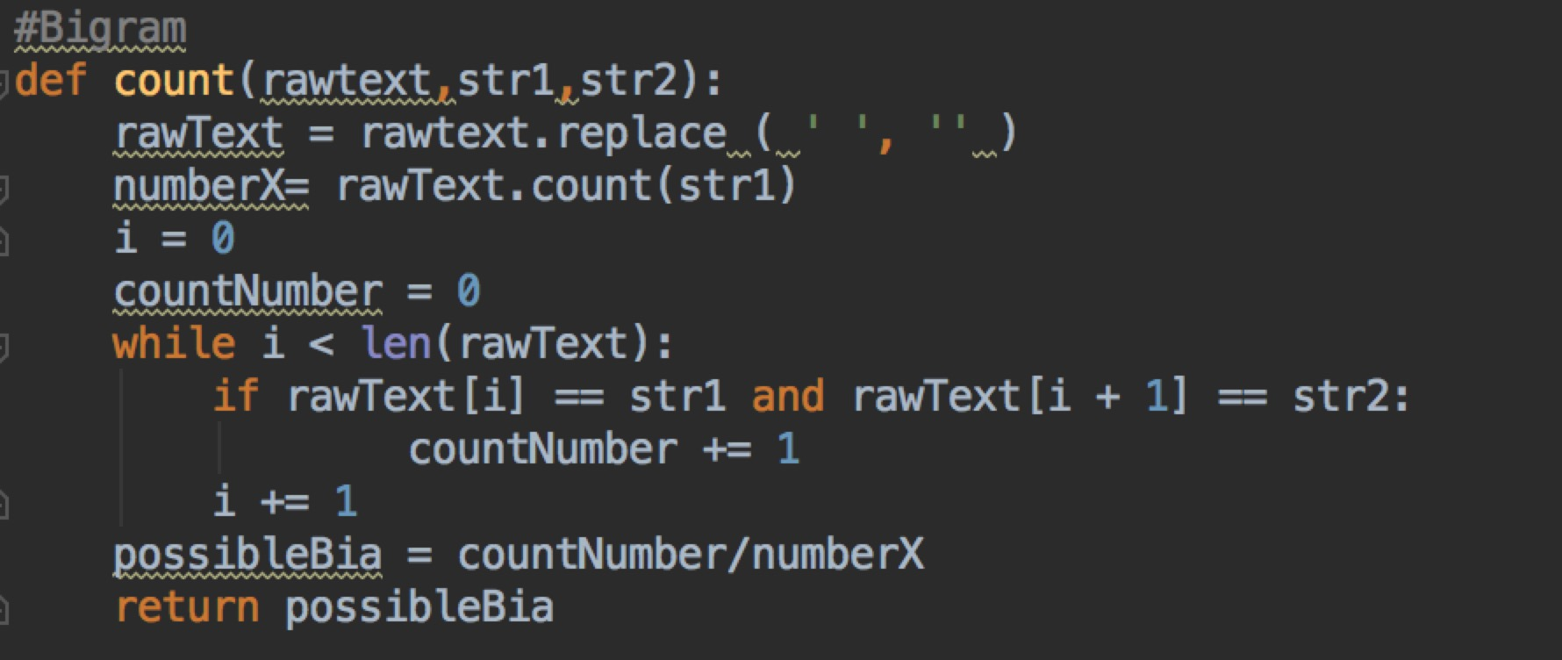
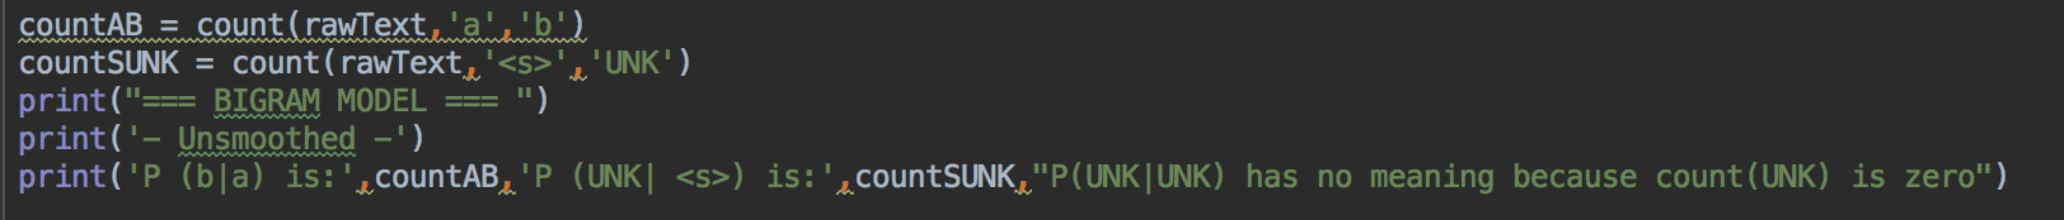
Compute the possibility of P(a|b),first we need to remove the blank from the text and get the count of b
Create a loop the get each letter in the sentence, if a[i]=str1 and a[i+1] = str2 ,we add 1 to the count number which is count(a,b)
Compute the possibility of b|a UNK|<s> and UNK|UNK

Slide 19
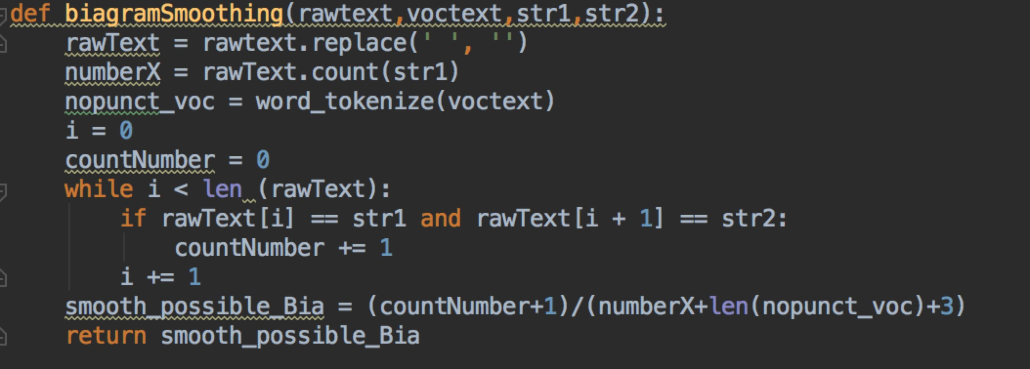
Result
We also need smoothing the data of biagram, it is quite same as unigram but a little different from
P(b|a) = (count(a,b)+1)/(count(a)+len(vocabulary)+3)

Slide 20
Smoothing result

Slide 21
Question 7

Slide 22
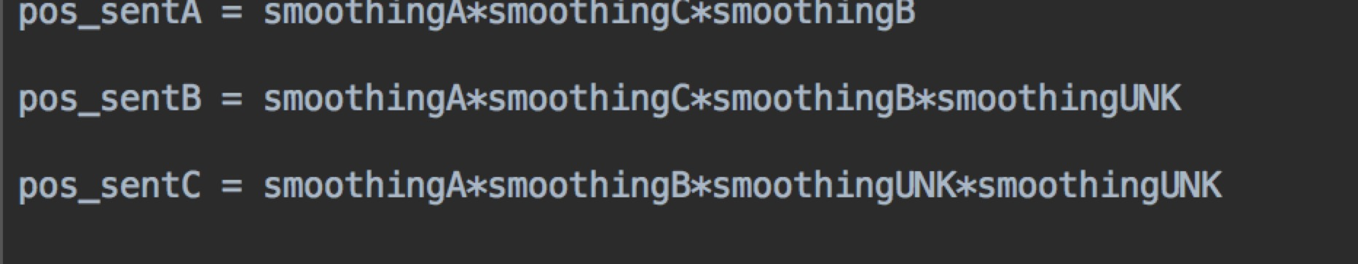
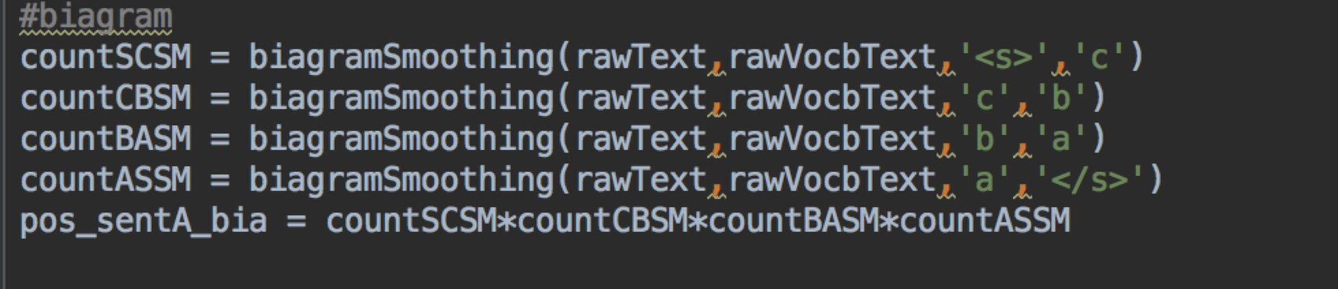
We need to know possibility of a,b,c,UNK after smoothed
P(abc) = P(a)*P(b)*P(C) because the possibility of a,b and c is indenpendent
It is same way to compute as unigram of P(abc) in biagram
P(abc) = P(a|<s>)*P(b|a)*P(c|b)*P(</s>|c)

Slide 23
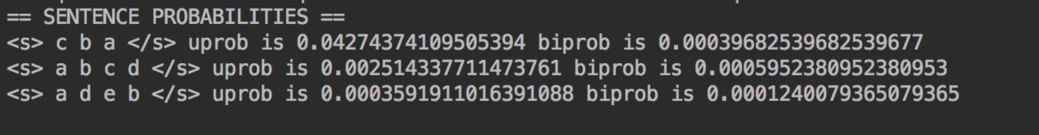
Result

